Slide 1


Re-analysis of Whole Genome Data for P. falciparum
HackBio Internship 2021
Team - Collins
Date - 13/08/2021

Slide 2
About Team Collins
Named after Francis Sellers Collins, who led the Human Genome Project (HGP).
Team of 19 members.
Common interest in Genomics and Bioinformatics

Slide 3
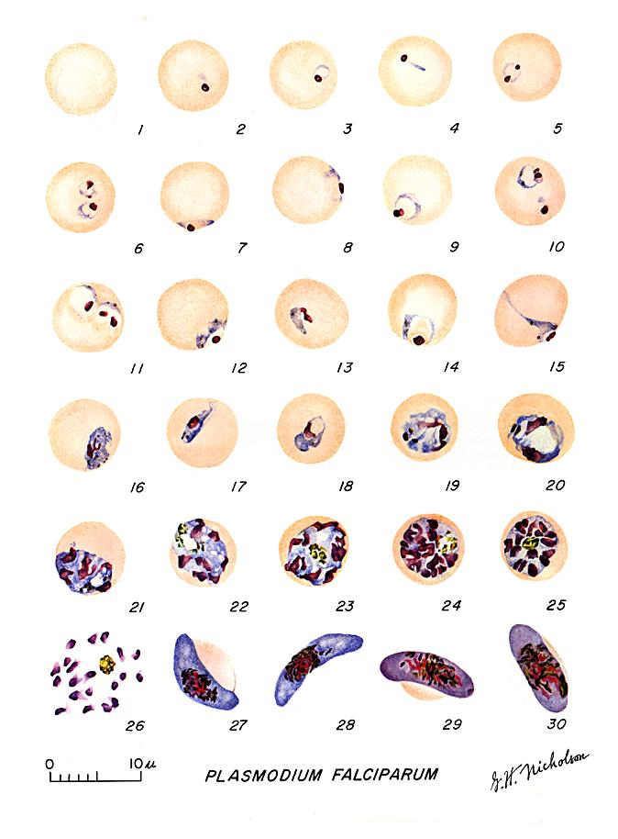
Introduction
Re-Analysis of whole genome of P. falciparum
Our team agreed to work on Plasmodium falciparum, which is a causative agent of the deadliest form of malarial disease. The objective of our analysis was to re-analyse a whole genome sequence of 24 SRA data(Sequence Read Archive), and perform a variant call analysis as well with a reference genome.

Slide 4
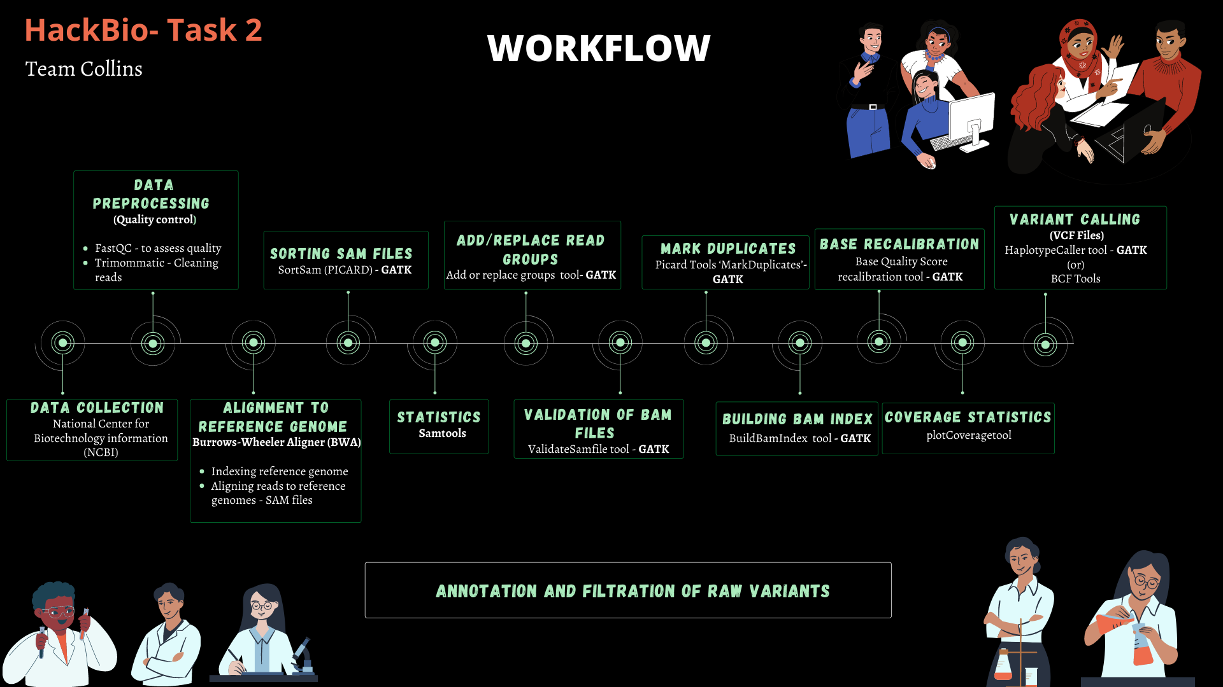
Workflow/Pipeline

Slide 5
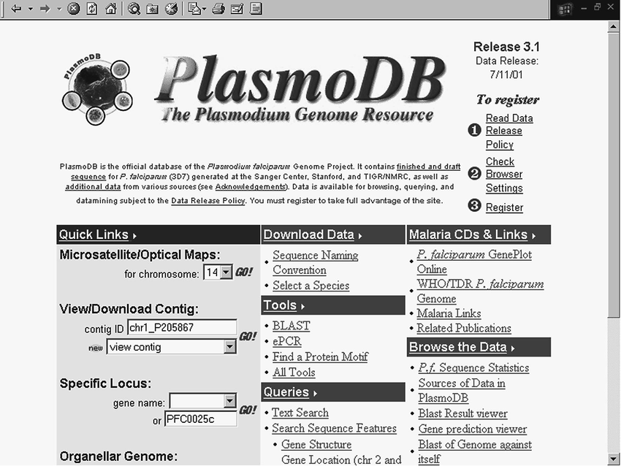


SOFTWARES AND TOOLS USED

Slide 6
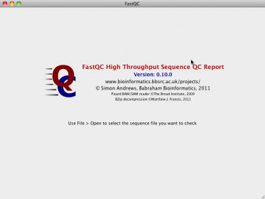

SOFTWARES AND TOOLS USED

Slide 7
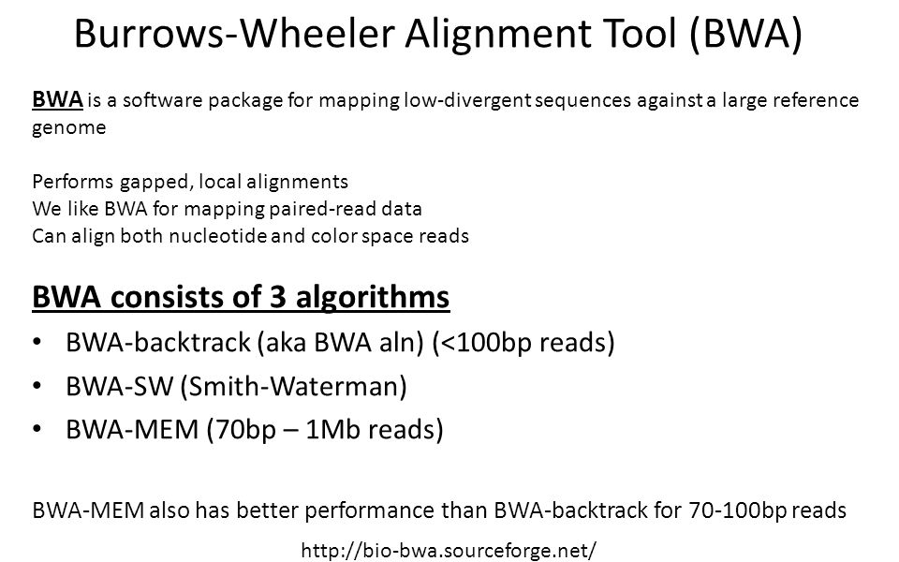

SOFTWARES AND TOOLS USED: ALIGNMENT

Slide 8

SOFTWARES AND TOOLS USED: SORTING
Read Group tool by the Picard
ValidateSameFile Tool from Picard.

Slide 9
SOFTWARES AND TOOLS USED: DUPLICATE READS
Mark Duplicate reads by Picard
Build BAM File from Picard.
BQSR

Slide 10
SOFTWARES AND TOOLS USED: ANNOTATION
Variant Calling

Slide 11
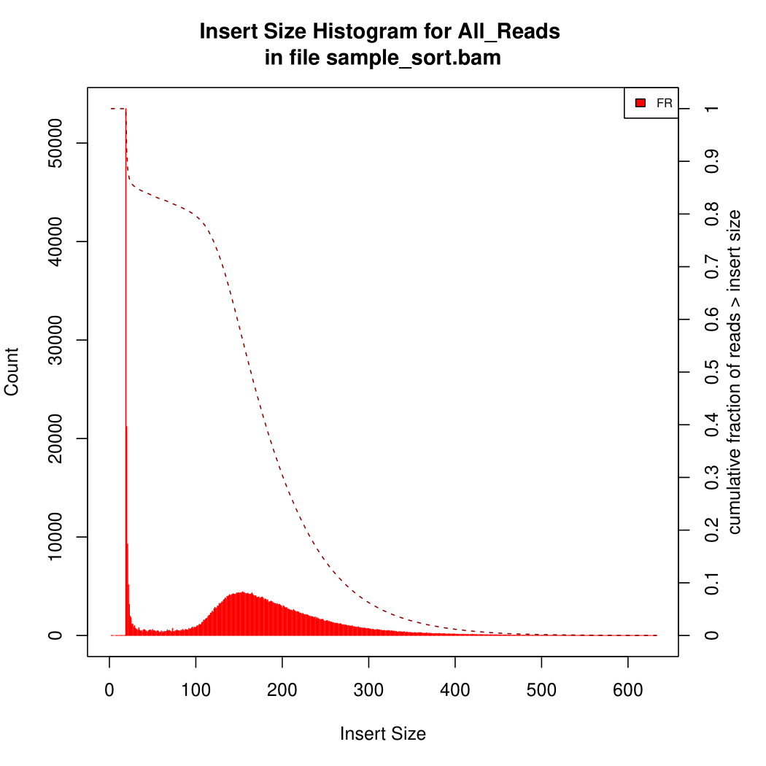
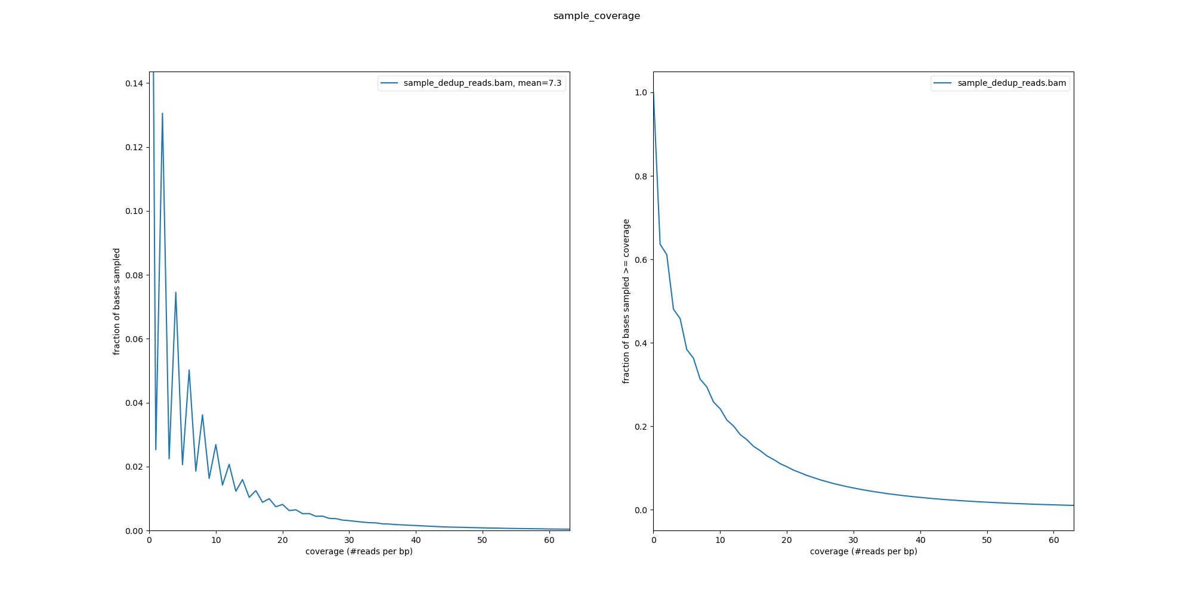
VISUALIZATION OF RESULTS

Slide 12
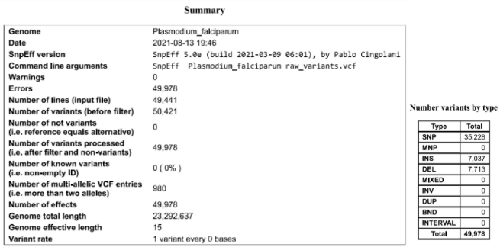
VISUALIZATION OF RESULTS

Slide 13
CONCLUSION
Despite rigorous effort made to control malaria (the deadliest killer disease ever known), it is still among the main public health problems in least developed regions of the world. OUR TEAM re-analysed the genome data of Plasmodium falciparum, the most virulent form of Plasmodium specie using various bioinformatic tools.
Team Collins hopes to use bioinformatic approaches to improve the knowledge of malarial epidemiology, diagnosis, treatment, vaccine development, and surveillance strategies.

Slide 14
THANK YOU! VIDEO BY: TEAM COLLINS ☺

